Slide 1
Module 2: Azure SQL Databases

Slide 3
Azure SQL Database Architecture
Client Layer
PHP
SQL Server
Applications
and Tools
WCF Data Services
Client Layer
Used by the application to communicate directly with Azure SQL Database
Services Layer
Gateway between Client Layer and Platform Layer
Platform Layer
Includes physical servers and services that support the Services Layer
Infrastructure Layer
IT administration of the physical hardware and operating system
ODBC/JDBC
ADO.NET
Tabular Data Stream (TDS)
TDS+SSL
Services Layer
Provisioning
Provisioning
Provisioning
…
Billing and Metering
Billing and Metering
Billing and Metering
…
Connection Routing
Connection Routing
Connection Routing
…
Platform Layer
SQL Server
SQL Server
SQL Server
…
SQL Database Fabric
SQL Database Fabric
SQL Database Fabric
…
Management Services
Management Services
Management Services
…
Infrastructure Layer
Notes:
Explain the architecture of the Azure SQL Database

Slide 4
Service Tiers
Basic
Standard
Premium
Best suited for a small size database, supporting typically one single active operation at a given time
The go-to option for most cloud applications, supporting multiple concurrent queries
Designed for high transactional volume, supporting a large number of concurrent users and requiring the highest level of business continuity capabilities
Notes:
All three service tiers have an uptime SLA of 99.99%
Basic
Basic tier is designed for applications with a light transactional workload. A typical use case is a lightweight application that needs a small database with a single operation at any given point in time.
Standard
Standard tier is the go-to option for getting started with transactional workloads. It offers better performance and better built-in business continuity features compared to Basic tier. A typical use case is an application with multiple concurrent transactions.
Premium
Premium tier is designed for mission-critical applications. It offers the best level of performance and access to advanced business continuity features including active geo-replication in up to 4 Azure regions of your choice. A typical use case is a mission-critical application with high transactional volume and many concurrent users.

Slide 5
Overview of the Performance Model
 | BASIC | STANDARD |  |  |  | PREMIUM
 |  | S0 | S1 | S2 | S3 | P1 | P2 | P4 | P6 | P11 | P15
Max DTUs | 5 | 10 | 20 | 50 | 100 | 125 | 250 | 500 | 1000 | 1750 | 4000
Max database size | 2 GB | 250 GB | 250 GB | 250 GB | 250 GB | 500 GB | 500 GB | 500 GB | 500 GB | 4 TB | 4 TB
Max in-memory OLTP storage | N/A | N/A | N/A | N/A | N/A | 1 GB | 2 GB | 4 GB | 8 GB | 14 GB | 32 GB
Max concurrent workers | 30 | 60 | 90 | 120 | 200 | 200 | 400 | 800 | 1600 | 2400 | 6400
Max concurrent logins | 30 | 60 | 90 | 1200 | 200 | 200 | 400 | 800 | 1600 | 2400 | 6400
Max concurrent sessions | 300 | 600 | 900 | 1200 | 2400 | 30000 | 30000 | 30000 | 30000 | 30000 | 30000

Slide 6
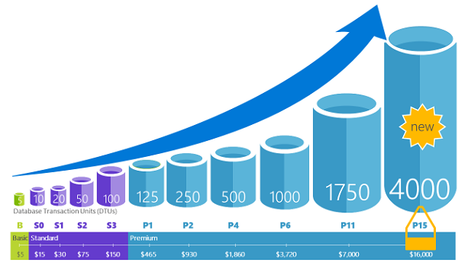
Database Transaction Units (DTUs)
Notes:
For a single Azure SQL database at a specific performance level within a service tier, Microsoft guarantees a certain level of resources for that database (independent of any other database in the Azure cloud) and providing a predictable level of performance. This amount of resources is calculated as a number of Database Transaction Units or DTUs, and is a blended measure of CPU, memory, I/O (data and transaction log I/O). Doubling the DTUs by increasing the performance level of a database is the same like doubling the set of resource available to that database. For example, a Premium P11 database with 1750 DTUs provides 350x more DTU compute power than a Basic database with 5 DTUs.
How can I determine the number of DTUs needed by my workload?
If you are looking to migrate an existing on-premises or SQL Server virtual machine workload to Azure SQL Database, you can use the DTU Calculator to approximate the number of DTUs needed.

Slide 7

Demonstration: DTU Calculator
Use the DTU Calculator to approximate the number of DTUs needed
Notes:
In this demonstration, you will learn which service tier and performance level you should use and how many database throughput units (DTUs) you are using now? This calculator will help you determine the number of DTUs for your existing SQL Server database(s) as well as a recommendation of the minimum performance level and service tier that you need before you migrate to Azure SQL Database. Knowing the minimum service tier will allow you to get the performance you need while minimizing your costs.
Demo setup instructions
Use the sql-perfmon-log.csv file to upload it into the DTU Calculator
Steps
1. Open a browser and go to http://dtucalculator.azurewebsites.net/
2. Explain briefly the instructions
3. Go to the Upload the CSV file and Calculate section and upload the sql-perfmon-log.csv file
4. Click the calculate button
5. Review the results. The result should be a Premium P6 database

Slide 8

A server is not a machine…
SQL Server
A Machine
SQL Database Server
A TDS* Endpoint
*TDS = Tabular Data Stream
Notes:
A SQL server is a physical server. When you talk about server in a data center
SQL database server. Basically this that looks like a SQL server instance but it is a TDS (Tabular Data stream) Endpoint.
It routes your requests to the physical primary replica
Don’t have to carry about VMs, hardware, …

Slide 9
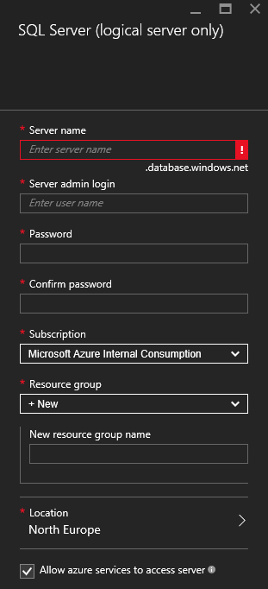
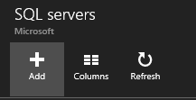
Server Provisioning
Service head that contains databases
Connect via Fully Qualified Domain Name
Initially contains only a master database
9
Notes:
We have the concept of a server but it’s just a logical grouping of databases.
You get a FQDN. Can’t change it. That’s your connections string and it will initially contains only a master database
To provision
Log on to the portal
Create server
Specify Admin login credentials
Specify the resource group
Select the location where you want to create the server
You can also use powershell to provision

Slide 10
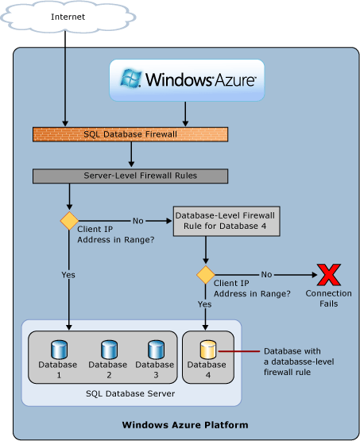
Azure SQL Database Firewall
IP Address-based access control for SQL Database
Rules at the server and/or database level
No IP authorized by default, not even Azure itself
Notes:
Firewall overview
Initially, all Transact-SQL access to your Azure SQL server is blocked by the firewall. To begin using your Azure SQL server, you must go to the Azure portal and specify one or more server-level firewall rules that enable access to your Azure SQL server. Use the firewall rules to specify which IP address ranges from the Internet are allowed, and whether Azure applications can attempt to connect to your Azure SQL server.+
To selectively grant access to just one of the databases in your Azure SQL server, you must create a database-level rule for the required database. Specify an IP address range for the database firewall rule that is beyond the IP address range specified in the server-level firewall rule, and ensure that the IP address of the client falls in the range specified in the database-level rule.+
Connection attempts from the Internet and Azure must first pass through the firewall before they can reach your Azure SQL server or SQL Database, as shown in the following diagram:

Slide 11
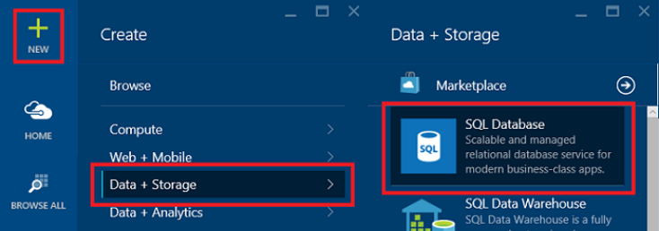
Create the database
New-AzureSqlDatabase -ResourceGroupName "resourcegroupsqlgsps"
-ServerName "server1" -DatabaseName "database1"
-Edition "Standard" -RequestedServiceObjectiveName "S1"
CREATE DATABASE MyFirstAzureSQLDatabase
(MAXSIZE = 500 MB, EDITION = 'standard', SERVICE_OBJECTIVE = 'S1');

Slide 12
Demonstration: Create your first Azure SQL Database
Create a new server, configure the firewall rules and create an Azure SQL Database
Notes:
Steps
Connect to the Azure Portal and browse to SQL Server (logical server)
Create a logical server
Server Name myazuresrv
Server Admin Login AzureAdmin
Password Passw0rd1
Confirm password Passw0rd1
Subscription Select your subscription
Resource Group Create New and specify the name AzureDB-RG
Location Select the location that is the closest to your location
Create the firewall rules on the logical server
Create Azure SQL Database with the portal
Database name Salesdb
Subscription Select your subscription
Resource Group Use Existing and select the Resource Group AzureDB-RG
Select Source Blank Database
Server Myazuresrv
Want to use SQL elastic pool? Not now
Pricing Tier Basic
Collation SQL_Latin1_General_CP1_CI_AS

Slide 13
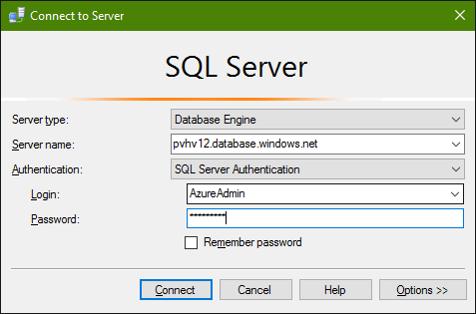
SQL Server Management Studio
Download the latest version of SSMS
Get your fully qualified Azure SQL server name
Connect to your SQL Database

Slide 14
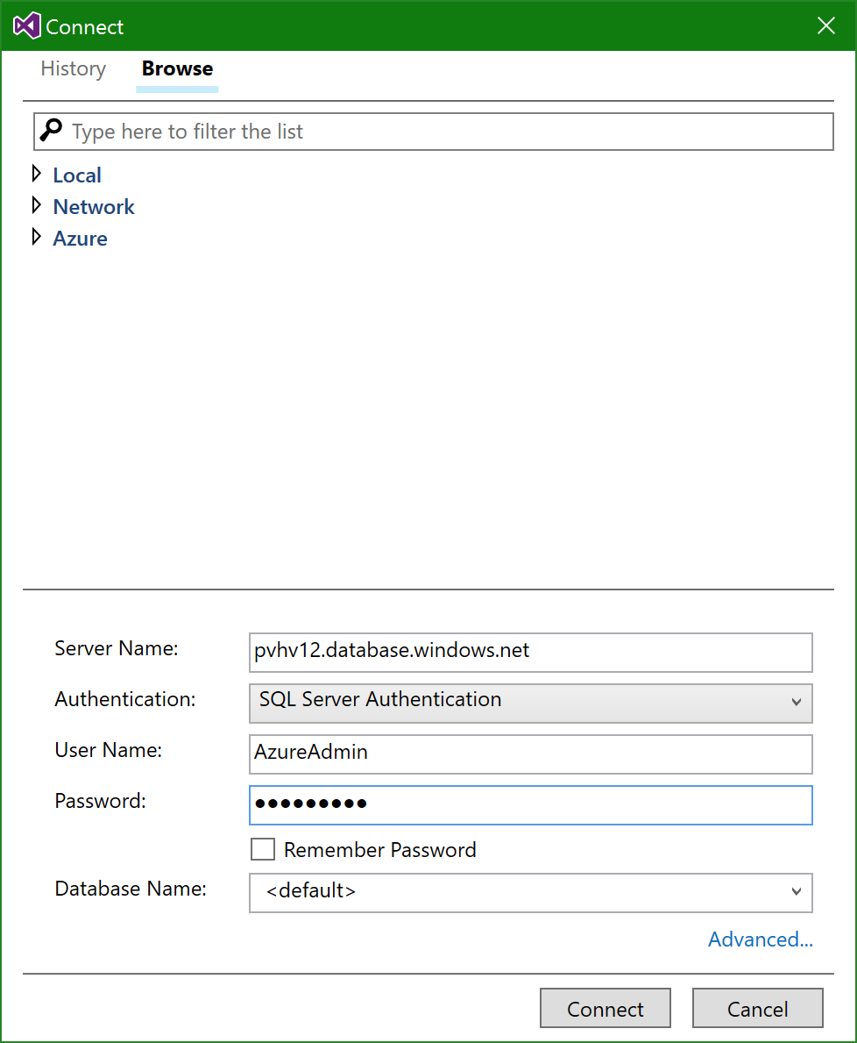
SQL Server Data Tools
Download the latest version of SSDT
Get your fully qualified Azure SQL server name
Connect to your SQL Database

Slide 15
PowerShell
Configure your credentials
Login-AzureRmAccount
Select your Azure subscription
Select-AzureRmSubscription -SubscriptionId 4cac86b0-1e56-bbbb-aaaa-000000000000
Create a resource group
$AzureSQLLocations = (Get-AzureRmResourceProvider - ListAvailable | Where-Object {$_.ProviderNamespace -eq 'Microsoft.Sql'}).Locations
Create a server
New-AzureRmSqlServer -ResourceGroupName "resourcegroupJapanWest" -ServerName "server12" -Location "Japan West" - ServerVersion "12.0“

Slide 16
PowerShell
Create a server firewall rule
New-AzureRmSqlServerFirewallRule -ResourceGroupName "resourcegroupJapanWest" -ServerName "server12" -FirewallRuleName "clientFirewallRule1" -StartIpAddress "192.168.0.198" -EndIpAddress "192.168.0.199“
Create a SQL Database
New-AzureRmSqlDatabase -ResourceGroupName "resourcegroupJapanWest" -ServerName "server12" -DatabaseName "TestDB12" - Edition Standard -RequestedServiceObjectiveName "S1"

Slide 17
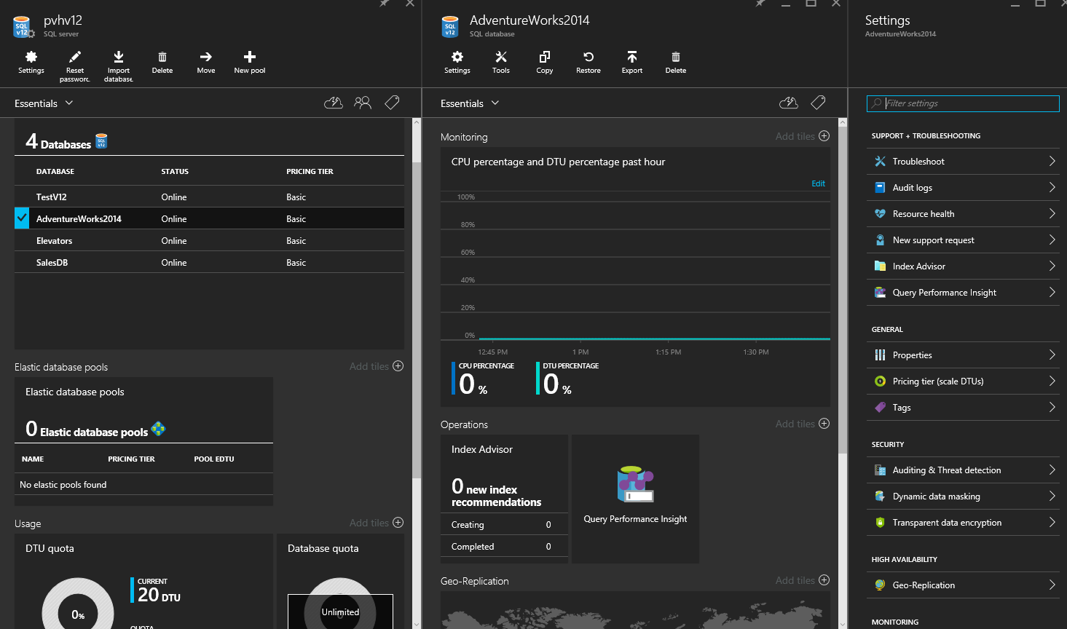
Azure Portal
Notes:
Describe what is available in the Azure Portal to manage your Azure SQL Database
The Azure portal is a web-based application where you can create, update, and delete databases and logical servers and monitor database activity. This tool is great if you're just getting started with Azure, managing a few databases, or need to do something quickly.
https://docs.microsoft.com/en-us/azure/sql-database/sql-database-manage-portal

Slide 18

Lab: Create and Manage Azure SQL Database

Slide 19
Motivations
Azure SQL Datababase
Billed hourly
Fixed rate based on the service tier
Reduce administration cost
SQL Server in Azure VM
Traditional SQL Server licensing
Cost depends on the VM size and the version of SQL Server
Billed per minute
SQL License cost
Windows License cost
Azure Storage
Notes:
What are the most common motivations to choose for Azure SQL Database or SQL Server on Azure VM

Slide 20
Administration
Azure SQL Database
Microsoft administers the physical hardware
Provide high availability
Upgrades the database software
Manages load balancing
Transparent failover
SQL Server in Azure VM
You have full control over the OS and SQL Server
You decide when to update/upgrade the OS and database software
You can control the size of the VM

Slide 21
Introduction – Scale up or down
Scale up with one click
Accommodate growth and peak workloads
Pay for what you need, when you need it
5 | 10 | 20 | 50 | 100 | 125 | 250 | 500 | 1,000 | 1,750 | 4,000
Database transaction units (DTUs)
Basic | Standard | Premium
Notes:
Scales performance on the fly, without app downtime.
When demand for your app grows from a handful of devices and customers to millions, SQL Database is the only service that can scale along with you, on the fly, with no app downtime.
Scale on the fly. With one mouse click in the Portal or a single API call, scale up the resources provided to your app to accommodate growth periods or peak workload demand.
Pay for what you need. Remove the guesswork and commitment of buying infrastructure to support the performance goals for your app. Only pay for the performance you need, when you need it.

Slide 22
Vertical Scaling
Upgrade to a Higher Service Tier
Downgrade to a Lower Service Tier
Change the Performance Level
Notes:
Vertical scaling refers to increasing or decreasing the performance level of an individual database

Slide 23
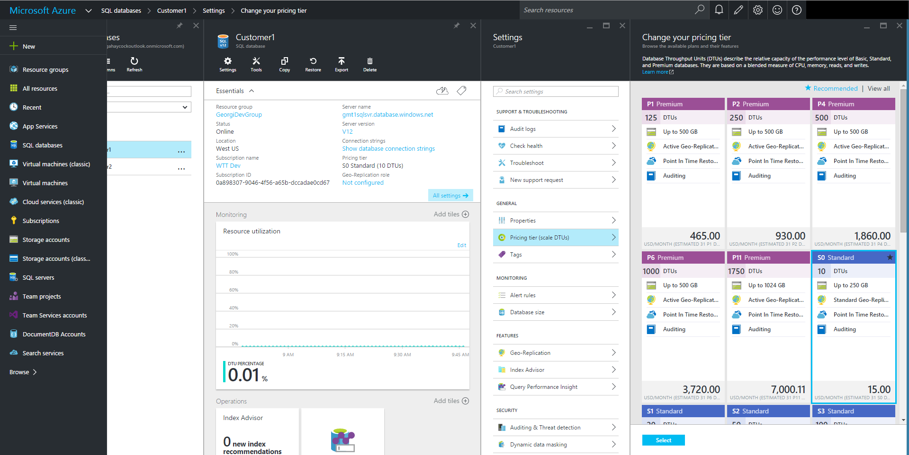
Changing Performance Levels
PowerShell
Set-AzureSqlDatabase
REST
Update database / ServiceLevelObjectiveId
.NET
Microsoft.WindowsAzure.Management.Sql. SqlManagementClient
client.Databases.Update(…)
T-SQL
ALTER DATABASE … MODIFY (EDITION = …)
Notes:
You can change the service tier and performance level of your SQL database with the Azure portal, PowerShell (using the Set-AzureSqlDatabase cmdlet), the Service Management REST API (using the Update Database command), or Transact-SQL (via the ALTER DATABASE statement). You can use DMVs to monitor the progress of the upgrade operation for a database. This allows you to easily scale up or down a database, and it will remain online and available during the entire operation with no downtime.
https://docs.microsoft.com/en-us/azure/sql-database/sql-database-manage-single-databases-powershell
https://docs.microsoft.com/en-us/azure/sql-database/sql-database-manage-single-databases-portal

Slide 24
Impact of Database Changes
Connections to the database may be temporarily dropped
No data is lost during this process
SLO change for a database often involves data movement
3 x (5 minutes + database size / 150 MB/minute)
Notes:
Changing the service tier and/or performance level of a database creates a replica of the original database at the new performance level, and then switches connections over to the replica. No data is lost during this process but during the brief moment when we switch over to the replica, connections to the database are disabled, so some transactions in flight may be rolled back.

Slide 25
Impact of Database Changes
The duration of the entire scale-up process depends on both the size and service tier of the database before and after the change.
Downgrading the service tier can cause a change in the backup retention periods.
Notes:
The duration of the entire scale-up process depends on both the size and service tier of the database before and after the change. For example, a 250 GB database that is changing to, from, or within a Standard service tier, should complete within 6 hours. For a database of the same size that is changing performance levels within the Premium service tier, it should complete within 3 hours.
o downgrade a database, the database should be smaller than the maximum allowed size of the target service tier.
When upgrading a database with Geo-Replication enabled, you must first upgrade its secondary databases to the desired performance tier before upgrading the primary database.
When downgrading from a Premium service tier, you must first terminate all Geo-Replication relationships. You can follow the steps described in the Recover from an outage topic to stop the replication process between the primary and the active secondary databases.
The restore service offerings are different for the various service tiers. If you are downgrading you may lose the ability to restore to a point in time, or have a lower backup retention period. For more information, see Azure SQL Database Backup and Restore.
The new properties for the database are not applied until the changes are complete.

Slide 26
Lab: Scale up or down an Azure SQL Database

Slide 27
Azure Automation
Microsoft Azure Automation provides a way for users to automate the manual, long-running, error-prone, and frequently repeated tasks that are commonly performed in a cloud and enterprise environment.
Notes:
Microsoft Azure Automation provides a way for users to automate the manual, long-running, error-prone, and frequently repeated tasks that are commonly performed in a cloud and enterprise environment. It saves time and increases the reliability of regular administrative tasks and even schedules them to be automatically performed at regular intervals. You can automate processes using runbooks or automate configuration management using Desired State Configuration.

Slide 28
Azure Automation- Runbook
Automating processes with runbooks
Runbook is a set of tasks that perform some automated process in Azure Automation.
Based on Windows PowerShell / Windows PowerShell Workflow.
Notes:
More information:
https://azure.microsoft.com/en-us/blog/azure-automation-your-sql-agent-in-the-cloud/

Slide 29
Azure Automation vs. SQL Server Agent Job
Azure Automation | SQL Server Agent Job
Create an Azure Automation Account | Create an SQL Server Agent Job
Create a runbook | Create a Job Step
Test the runbook | Start Job at Step
Publish the runbook | Save the job
Schedule the runbook | Schedule the SQL Server Agent Job
View jobs of the runbook | View History
Notes:
References:
https://azure.microsoft.com/en-us/blog/azure-automation-your-sql-agent-in-the-cloud/
https://blogs.technet.microsoft.com/uktechnet/2016/02/05/is-sql-server-agent-missing-from-azure-sql-database/

Slide 30
Lab: Scheduling jobs in Azure SQL database through Azure Automation

Slide 31
Azure SQL Database Elastic Pools
Ensure that databases get the performance resources they need, when they need it, while providing a simple resource allocation mechanism within a predictable budget
Elastic Database Pool
Databases consume resources as needed
Customer 1
Customer 3
Customer 2
…
Customer #N
Scale out/in the pool
Microsoft Confidential
Notes:
For further information, refer to the links below:
What is an Azure elastic database pool?
https://azure.microsoft.com/en-us/documentation/articles/sql-database-elastic-pool/
Elastic Azure SQL Databases with Torsten Grabs
https://channel9.msdn.com/Shows/Cloud+Cover/Episode-190-Elastic-Sql-Azure-Databases-with-Torsten-Grabs

Slide 32
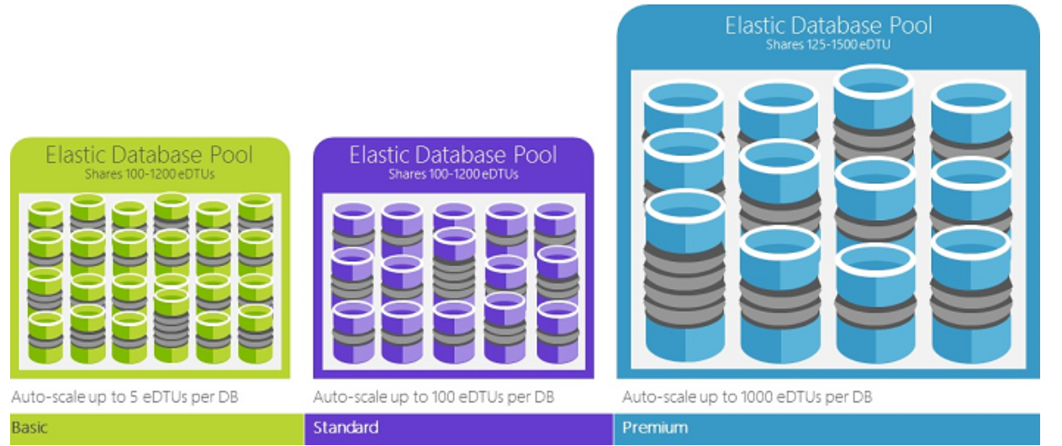
Elastic Database Transaction Unit – eDTUs
An eDTU is a unit of measure of the set of resources (DTUs) that can be shared between a set of databases on an Azure SQL server - called an elastic pool.
Elastic pools provide a simple cost effective solution to manage the performance goals for multiple databases that have widely varying and unpredictable usage patterns
A pool is given a set number of eDTUs, for a set price. Within the elastic pool, individual databases are given the flexibility to auto-scale within the configured boundaries
Microsoft Confidential
Notes:
What are elastic Database Transaction Units (eDTUs)
An eDTU is a unit of measure of the set of resources (DTUs) that can be shared between a set of databases on an Azure SQL server - called an elastic pool. Elastic pools provide a simple cost effective solution to manage the performance goals for multiple databases that have widely varying and unpredictable usage patterns. See elastic pools and service tiers for more information.
A pool is given a set number of eDTUs, for a set price. Within the elastic pool, individual databases are given the flexibility to auto-scale within the configured boundaries. Under heavy load, a database can consume more eDTUs to meet demand while databases under light loads consume less, up to the point that databases under no load consume no eDTUs. By provisioning resources for the entire pool, rather than per database, management tasks are simplified and you have a predictable budget for the pool.+
Additional eDTUs can be added to an existing pool with no database downtime and with no impact on the databases in the pool. Similarly, if extra eDTUs are no longer needed, they can be removed from an existing pool at any point in time. You can add or subtract databases to the pool, or limit the amount of eDTUs a database can use under heavy load to reserve eDTUs for other databases. If a database is predictably under-utilizing resources, you can move it out of the pool and configure it as a single database with predictable amount of resources it requires.
https://docs.microsoft.com/en-us/azure/sql-database/sql-database-what-is-a-dtu

Slide 33
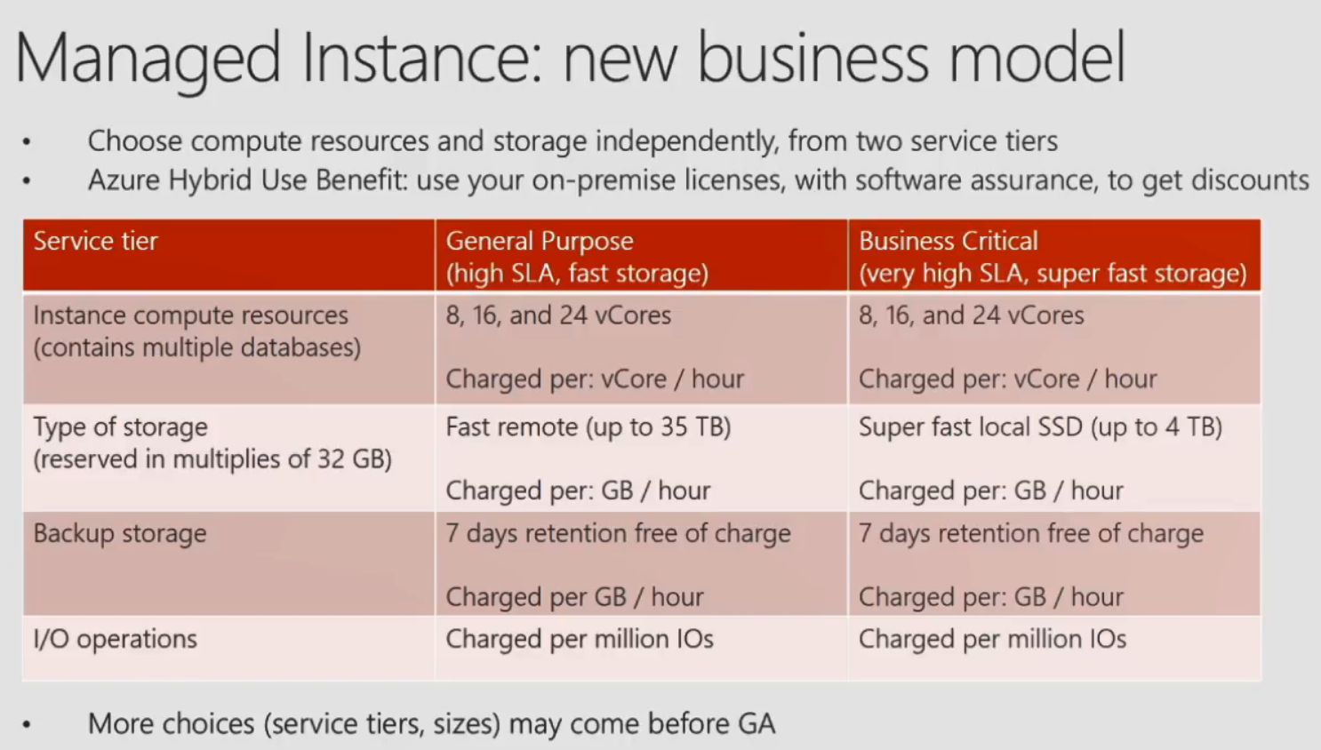
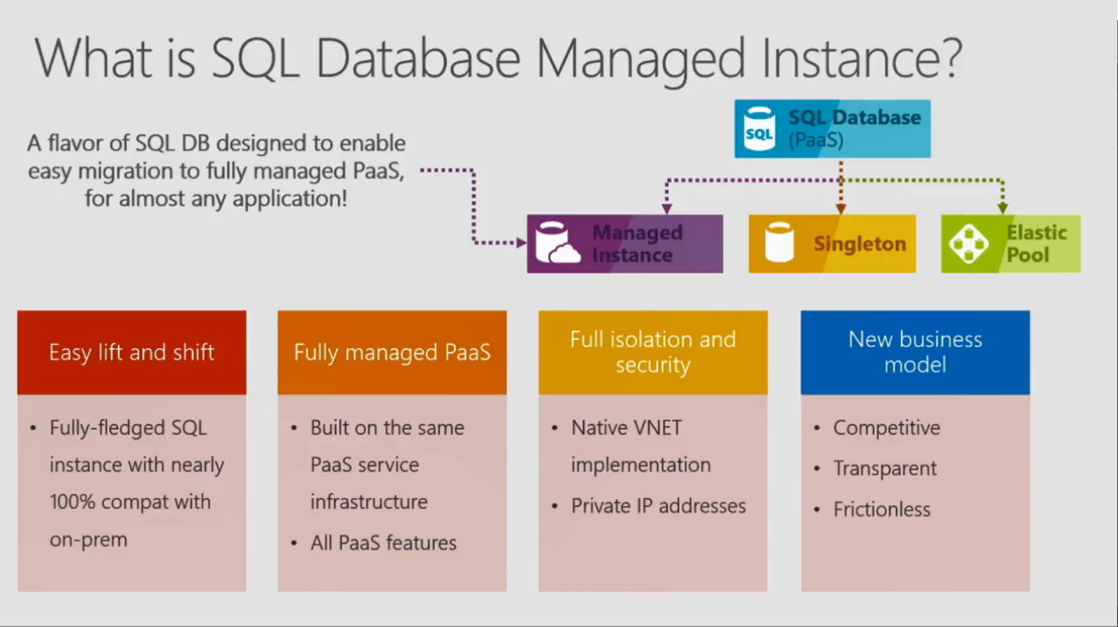

Slide 34
